Slide 1
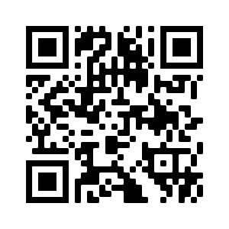
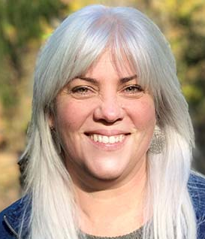
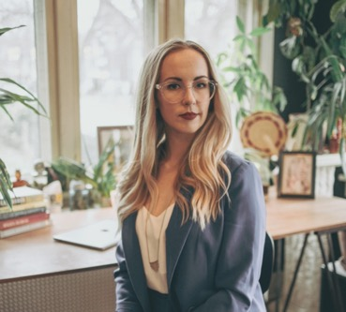
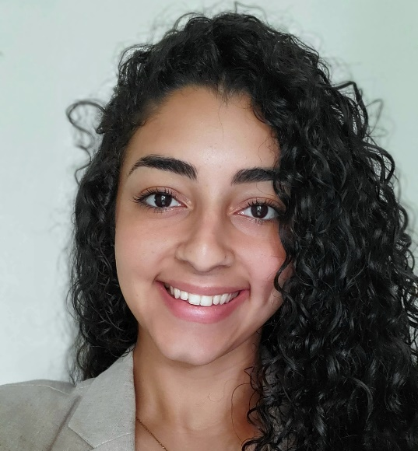
Exploring Bereavement & Grief Experiences in an Ongoing Collaborative Filmmaking Study: Preliminary Lessons Learned
Grace Checo, BS, Research Assistant; Sara Baumann, PhD, MPH, Assistant Professor, Behavioral and Community Health Sciences;
Jessica Burke, PhD, MHS Professor, Behavioral and Community Health Sciences
Why Visual Research Methods?
Scoping review we conducted found that film methods:
Provide rich descriptions
Capture emic perspectives
Increase comfort in participation
Empower participants
Can be used for advocacy
Community-engagement throughout the research process was limited (Baumann, Merante, Folb, Burke, 2019)
Filmmaking as Therapeutic tool
The impact of film and filmmaking have been explored as therapeutic tools in behavioral health studies; however, usually in group projects or guided by a psychotherapist.
Studies found that filmmaking helped participants:
- regain a sense of agency
- process trauma
- create therapeutic transformation
- initiate discussion with the resulting film
(Tuval-Mashiach, Patton, Drebing, 2018; Valeria, Sabatino, Chiara, Pastorino, Verrastro, 2020; Ludwin, Capstick, 2015)
Preliminary Lessons Learned in the Visualizing Loss Study
Participant recruitment & data collection is on-going. Seven participants currently involved in the Collaborative Filmmaking process addressing the filmmaking prompts:
What is your child's story/legacy and how does it impact your grief journey? What are some of the ways you express grief? What do you want others to know about your bereavement experience?
Co-creation of study logo helpful process for developing relationships with the participants and processing shared experiences
Prolonged filmmaking process from unexpected grief in the film-planning phase
“I can’t believe how hesitant I was when the equipment came”
“I didn’t think it would be this hard...But this broke me. In a good way.”
Thorough planning by study team before communicating with participants
E.g. text messages, sensitive interviewing, death anniversaries, inclusion of a social work team member, advisory board
More frequent reflections and debriefing sessions for/by the research team after watching films or hearing descriptions of child’s death
More frequent reflection and debriefing session for/by the research team after watching films or hearing descriptions of child's death
What is Collaborative Filmmaking?
Our Bereavement & Grief Study: Visualizing Loss Using Collaborative Filmmaking
Funded by the McElhattan Foundation
Research Collaboration with the Pediatric Palliative Care Coalition
Advisory board includes representation from PPCC administration & families, and academics with expertise in bereavement and palliative care
Generate 15 parent-created short films that document grief and coping experiences following the death of a child from a life-limiting illness following hospice of palliative care
Study the role of Collaborative Filmmaking as a therapeutic tool for participants navigating the grief journey after the loss of a child
Improve knowledge of grief and bereavement
experiences among audience members after
screening the parent-created films
Jessica Burke, PhD
Principal Investigator
Sara Baumann, PhD Co-Investigator
Grace Checo Research Assistant
Notes:
-Tuval-Mashiach, R., Patton, B. W., & Drebing, C. (2018). “When you make a movie, and you see your story there, you can hold it”: Qualitative exploration of collaborative filmmaking as a therapeutic tool for veterans. Frontiers in Psycholog
-Drebing, C. E., Mamon, D., Calixte, R. M., Tuval-Mashiach, R., Patton, B., Scoglio, A. A., ... & Penk, W. E. (2022). Pilot outcomes of a filmmaking intervention designed to enhance treatment entry and social reintegration of veterans. Psychological Services.
- LePage, P., & Courey, S. (2011). Filmmaking: A Video-Based Intervention for Developing Social Skills in Children with Autism Spectrum Disorder. Interdisciplinary journal of teaching and learning, 1(2), 88-103.
- Valeria, S., Sabatino, A. C., Chiara, I., Pastorino, G. M. G., & Verrastro, V. (2020). Filmmaking and video as therapeutic tools: Case studies on autism spectrum disorder.
- Ludwin, K., & Capstick, A. (2015). Using participatory video to understand diversity among people with dementia in long‐term care. Journal of Psychological Issues in Organizational Culture, 5(4), 30-38.
- Johnson, J. L., & Alderson, K. G. (2008). Therapeutic filmmaking: An exploratory pilot study. The Arts in Psychotherapy, 35(1), 11-19.

