Slide 1
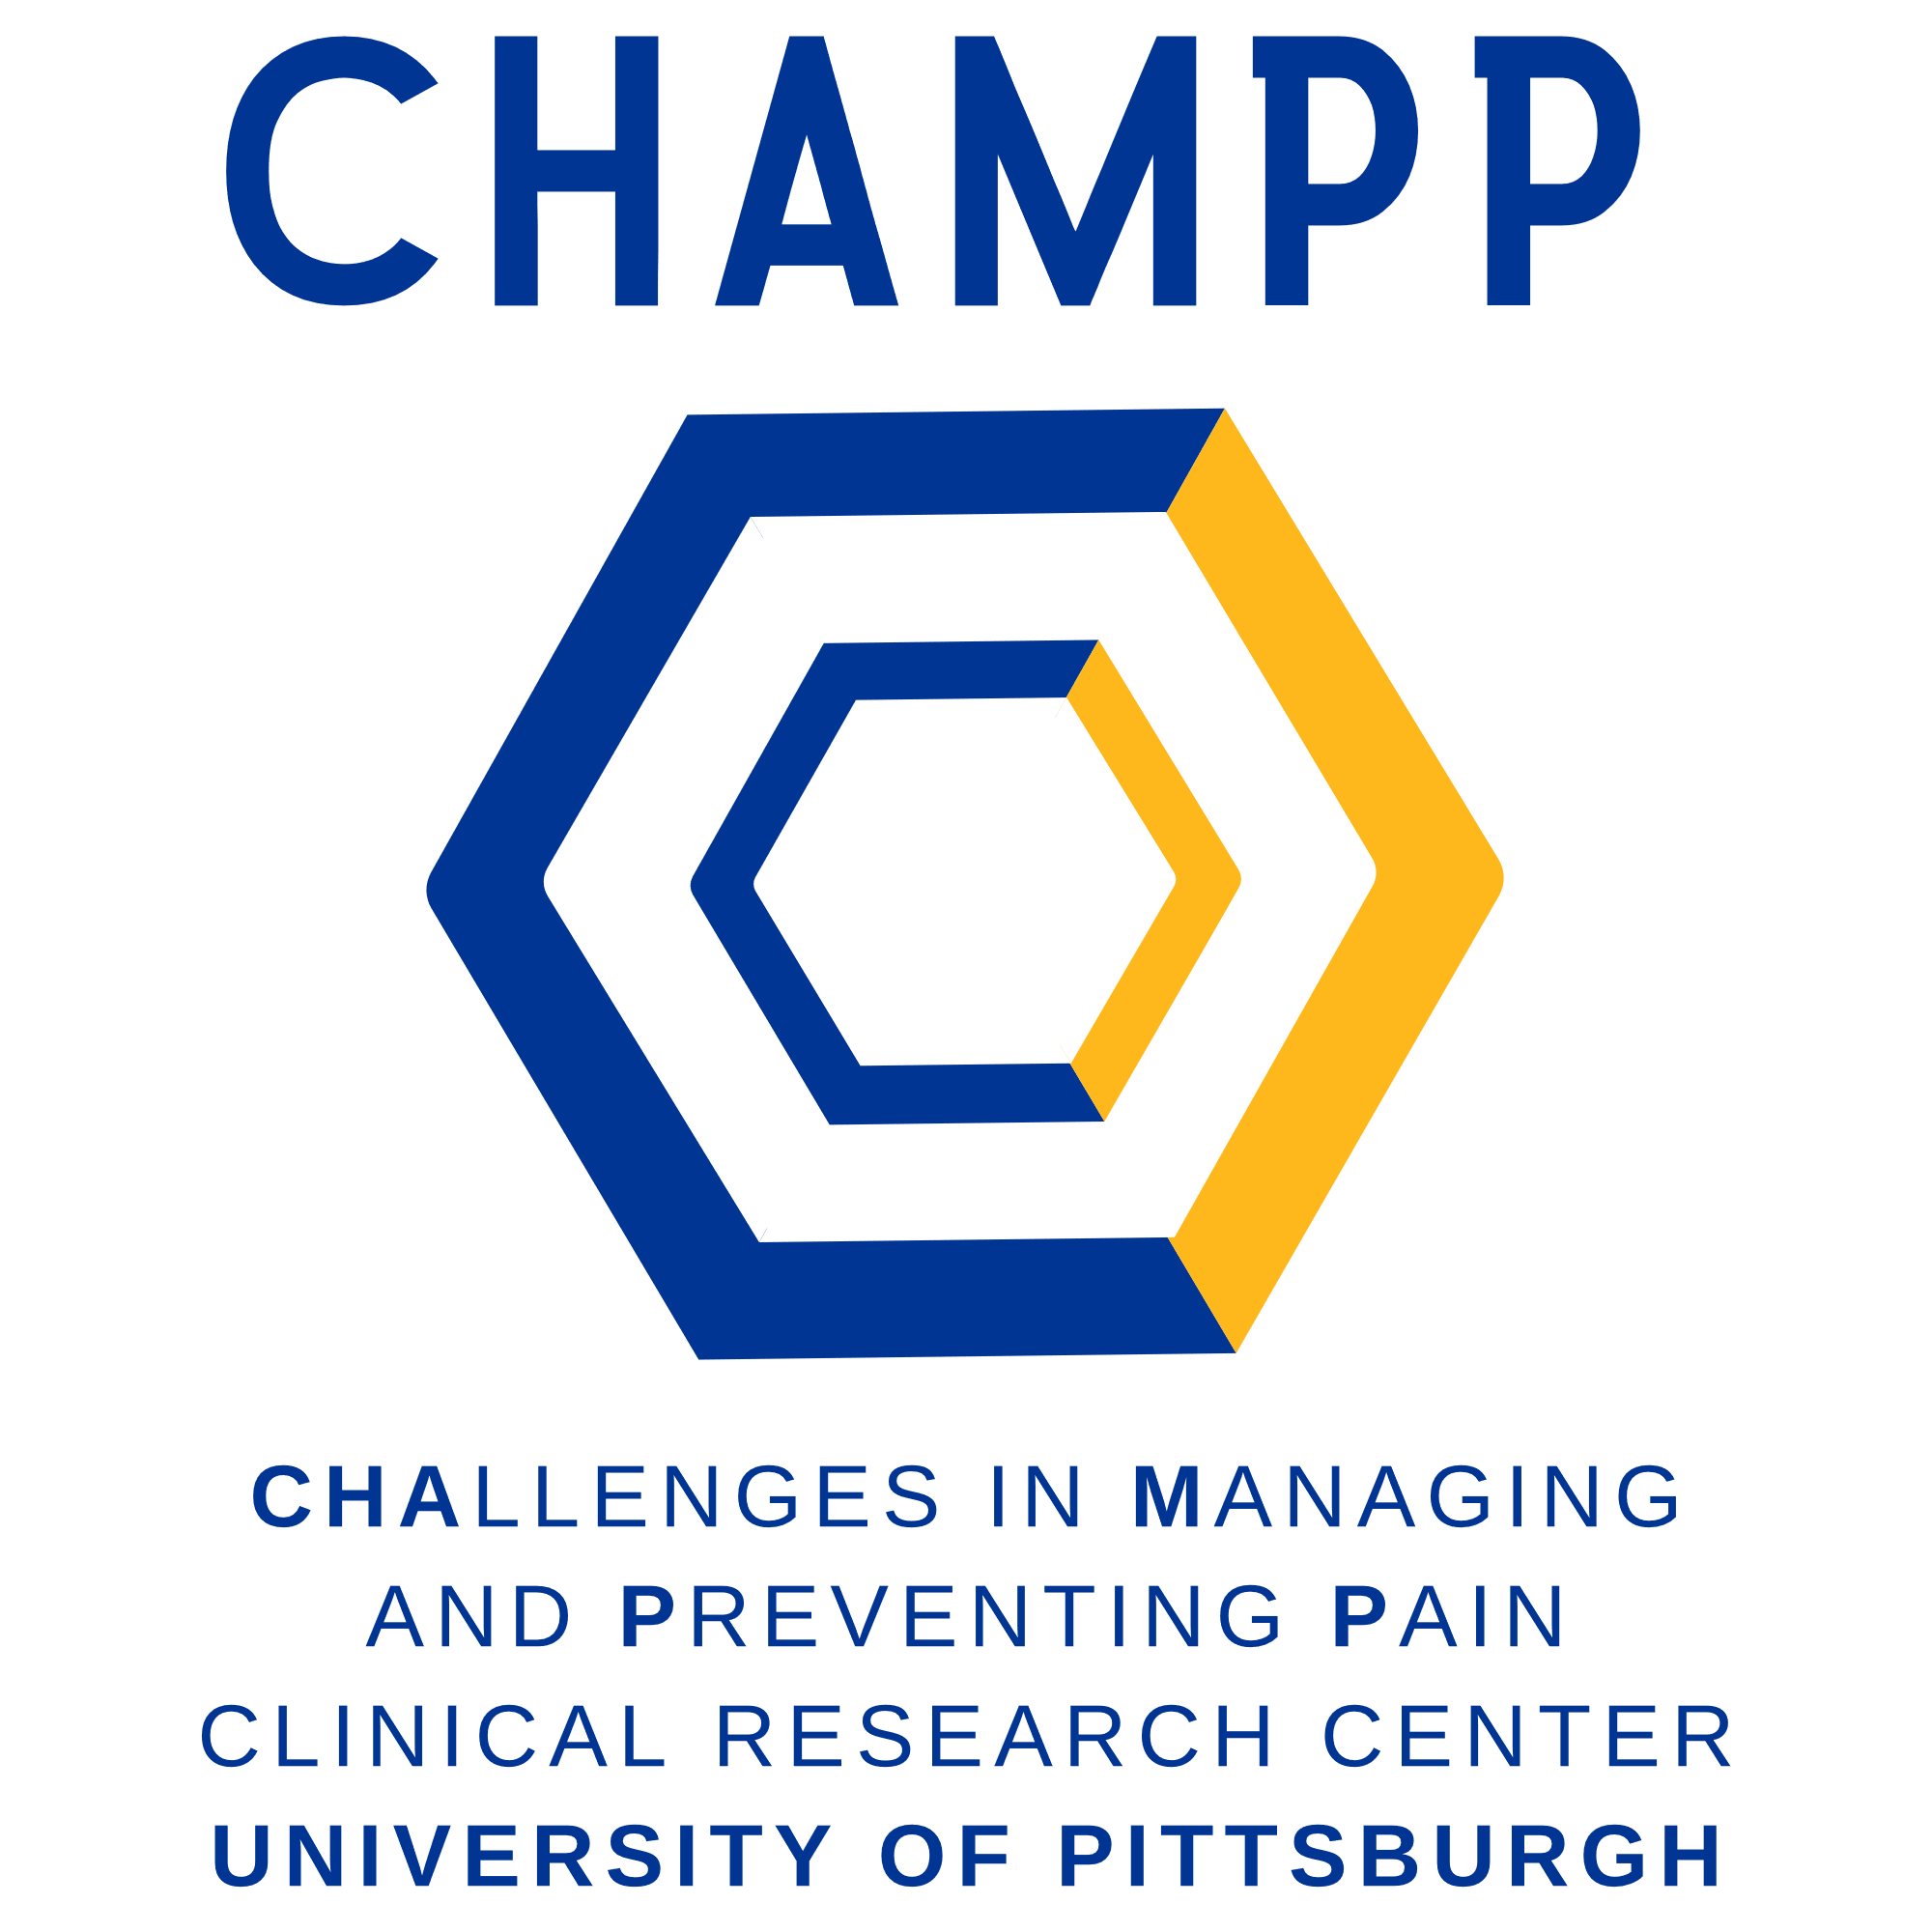
Challenges in Managing and Preventing Pain (CHAMPP)
Clinical Research Center
Dr. Jessica Merlin MD, PhD, MBA (director) and Dr. Hailey Bulls PhD, MA (co-director)
About CHAMPP
Guiding Principals and Action Plans
Examples of Currently Funded Projects
Works In Progress Series
History
The CHallenges in Managing and Preventing Pain (CHAMPP) Clinical Research Center is housed within the University of Pittsburgh's Division of General Internal Medicine. It was founded in 2020.
Our Mission
The mission of CHAMPP is to improve health and healthcare for patients with pain by building an interdisciplinary and inclusive collaborative of clinical pain researchers.
Conduct high quality pain research:
Advance the science in the field of pain prevention and management
Manage pain effectively in patients with complex presentations, such as individuals with serious illness and comorbid substance use disorder
Prevent the development of chronic pain, especially in people with serious illness
2. Champion diversity and inclusion in research and practice:
Promote diversity in clinical settings and combat racism and bias in academia
Serve as a diverse presence in the Pitt community that embodies diversity in race, ethnicity, national origin, color, sex, sexual orientation, gender identity or expression, age, marital status, political belief, religion, immigration status, and mental or physical ability.
Provide research and mentorship opportunities for underrepresented minority trainees and faculty
3. Create a campus-wide pain community:
Provide a hub for researchers across campus to grow our community, share resources, foster interdisciplinary collaboration, and ultimately advance the science in this field
Bring together University resources and centers (e.g., basic science-focused Pittsburgh Center for Pain Research; PCPR) and other clinical departments
Form interdisciplinary interactions required for innovation and rapid translation from discovery into clinical practice.
Provide opportunities for professional development and grant writing support (e.g. works in progress series; professional development grant)
4. Cultivate talent:
Mentor and train the next generation of pain researchers through formal and informal means
Mentor and support the involvement of undergraduate, graduate, and medical students in clinical and translational pain research
Support postdoctoral fellows as they move into independent scholarship
5. Connect and grow:
Serve as a central point of contact for researchers outside of the Pitt community to foster inter-institutional collaborations
Visiting speaker series
Visiting professors
6. Communicate and disseminate:
Translate important research findings in the field into practice, both locally and nationally
Implement pain prevention and management strategies in special populations (e.g., people with HIV) and settings (e.g., primary care, the emergency department)
Assessing the Transition from Acute to Chronic Cancer Pain (AtTACC Pain) Study
Consensus-based algorithms to address opioid misuse behaviors among individuals prescribed long-term opioid therapy: developing implementation strategies and pilot testing
Consensus-based approach to managing opioids, including opioid misuse and opioid use disorder, in patients with serious illness
Mentoring the next generation of researchers at the intersection of opioid use disorder and chronic pain
Opioid therapy for pain in individuals with metastatic cancer: benefits, harms and stakeholder perspectives
Evaluation of the efficacy and mechanisms of a novel intervention for chronic pain tailored to people living with HIV: Skills To Manage Pain (STOMP)
Tailored Retention and Engagement for Equitable Treatment of OUD and Pain (TREETOP)
Integrating brain and behavioral measures of central pain inhibition to personalize treatment in chronic pain management
University of Pittsburgh Hub and Spoke Pain Clinical Trial Network
Creating a multi-level intervention to reduce stigma for buprenorphine use for individuals with End Stage Kidney Disease (ESKD) and Chronic Pain
Pain Reduction and Opioid Medication Safety in ESRD (PROMISE) study
An in-depth Examination of the Psychological Processes involved in the Transition from Acute to Chronic Pain after a Traumatic Musculoskeletal Injury
Improving Pain Management and Opioid Safety for Patients with Cirrhosis
An informal venue to discuss planned or on-going projects and foster collaboration across the university
Aims pages, manuscripts, etc.
Third Thursday of each month
Strategic Planning
SBDC
Actively working with Pitt’s SBDC for strategic planning
New, Larger Office Space
Planning phase. Move-in estimated Spring 2023
Social Media
Facebook, Instagram, Twitter, and LinkedIn being used to build awareness and increase reach.
Outreach
Generated a list of other, similar research centers across the country. List will be used for both networking and potential future collaboration.
Fundraising
Exploring outside donor opportunities to support continuing research
Core Investigators
Jessica Merlin MD, PhD, MBA CHAMPP Director
Chronic pain & opioid misuse in individuals with serious illness
Hailey Bulls PhD, MA, CHAMPP Co-Director
Behavioral pain management in patients with serious and/or chronic illness
Benedict Alter MD, PhD
Brain modulation of pain
Manisha Jhamb MD, MPH
Understanding and improving patient-centered outcomes
Charles Jonassaint PhD, MHS
Chronic disease self-management and CBT
Maria Pacella-LaBarabra PhD
Psychological intervention to prevent transition to post-injury chronic pain
Shari Rogal MD, MPH
Implementation science
Katie Suda PharmD, MS
Pharmacoepidemiology
Contact us
champp.pitt.edu
CHAMPP@pitt.edu
@pittchamp
Submitted Grant Applications
Building an Interprofessional and Diverse workforce in substance Use and Pain (T32)
Mentoring the next generation of researchers at the intersection of opioid use disorder and chronic pain (K24)

