Slide 1
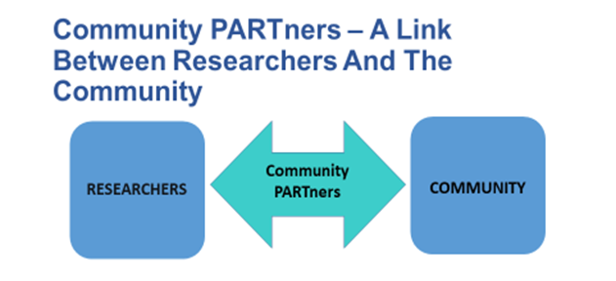
Older Adult Community Engagement Studios:
A service to improve outreach
& recruitment of older adults in your research
Janelle Christensen, MA, MPH, PHD, Steve Albert, PHD, Mylynda Massart, MD, PHD, RaNaja Kennedy, Leah McKown
BACKGROUND
METHODS
Problematic historical exclusion of older adults from research studies. Researchers may be:
Unaware of importance
Intimidated by barriers
Promote the use of the OA-CES and OA-Mind Bank.
Use and share what we learn.
Older Adult Community Engagement Studios
(OA-CES)
OBJECTIVES
Develop and Train Diverse OA-CES.
Collaborate with researchers to hold 14 OA-CES to evaluate design and recruitment strategies.
Select and tailor implementation strategies to counter barriers to inclusion, ultimately creating a Toolkit.
FUTURE DIRECTIONS
Contact us to schedule a consult
Create an Including Older Adults Toolkit to outline best practices for including them into research at the University of Pittsburgh/ UPMC
Email: pepperoa@pitt.edu
Phone: 412-692-2843
To Learn more about CES, see: Vanderbilt Institute for Clinical and Translational Research (VICTOR): https://victr.vumc.org/community-engagement-studio
Email: pepperoa@pitt.edu
Phone: 412-692-2843
Notes:
Questions:
[ ] QR code

