Slide 1
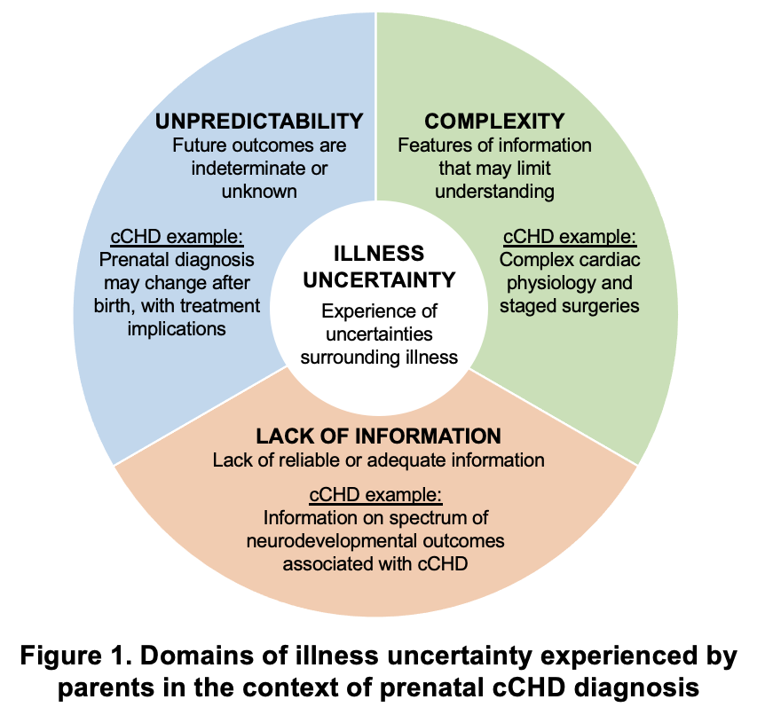
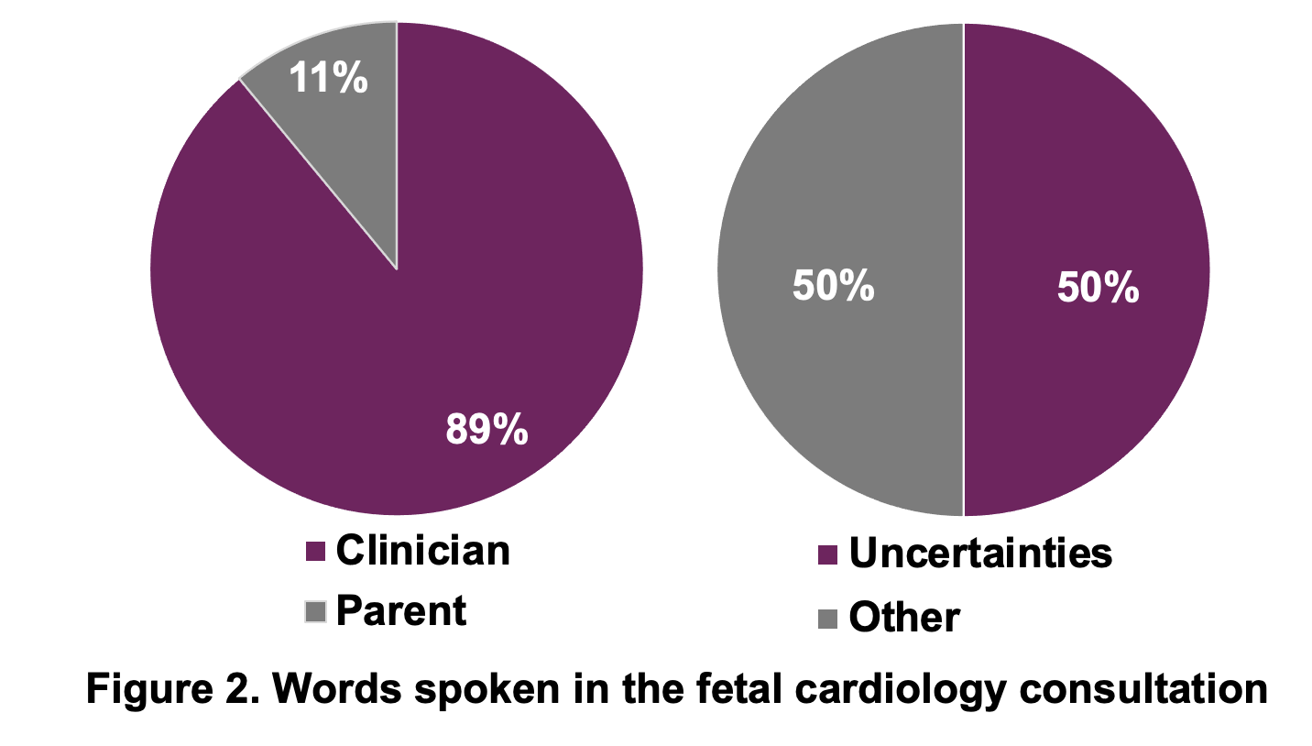
Introducing Uncertainty: An Observational Study of Conversations on Prenatal Diagnosis of Complex Congenital Heart Disease
Kelly W. Harris, MD¹; Kelsey Schweiberger, MD, MS¹; Ann Kavanaugh-McHugh, MD²; Robert M. Arnold, MD¹;
Jessica Merlin, MD, PhD, MBA¹; Judy C. Chang, MD, MPH¹*; Nadine Kasparian, PhD^{3*}
¹ University of Pittsburgh Medical Center; ² Vanderbilt University Medical Center; ³ Cincinnati Children’s Hospital
*Shared Senior Authorship
BACKGROUND
Parents who receive a prenatal diagnosis of complex congenital heart disease (cCHD):
Experience severe psychological distress
Identify uncertainties as key sources of distress
Illness Uncertainty: Experience when illness-related events are unclear and outcomes uncertain
PROJECT OBJECTIVE
To examine initial fetal cardiology consultation conversations to describe when and how uncertainty was communicated
METHODS
Design: Observational, qualitative study of clinician-parent conversations at initial prenatal fetal cardiology consultations for cCHD.
Sample: 19 consultations across 5 fetal cardiology clinicians at 1 academic institution. All audio-recorded and transcribed verbatim.
Analysis: 2 coders inductively developed and applied codebook to code content and communication approaches (e.g., turn-taking, framing), adjudicating to full agreement. Focus on coding uncertainty and identified associated topics
RESULTS
Table 2. Illness Uncertainty Topics of Discussion
Diagnosis* | “I’m not sure we will know [the details] for sure until after he’s born.” Clinician to Family 15
Etiology | “For a lot of them, we don't know exactly why it happens, and it's not the cause or fault of either parent or anything done in the pregnancy. It's just a difference that about one in a hundred babies have.” Clinician to Family 4
Co- morbidities | “30% of babies who have differences of their heart have differences of other organs” Clinician to Family 5
Prognosis* | “There's probably about a 50% chance this baby will survive to delivery… about a 20% chance… past the neonatal period” Clinician to Family 10
Birth^ | “If he looks perfectly fine, they're going to give him back to you to hold for about 10 minutes… [then] start the medicine that keeps that blood vessel open.” Clinician to Family 13
Logistics^ | “We know we’re going to have to be here for an extended time… we couldn’t afford to stay in a hotel for two weeks or longer.” Mother from Family 20 to Clinician
Therapeutics* | “Ultimately, the proof is after he gets here… whether or not he’s going to need intervention before you guys go home from the hospital.” Clinician to Family 11
*Topics discussed most frequently overall ^Topics raised by parents most frequently
Table 1: Demographics | n (%)
Pregnant Individuals (N = 19)
White, Non-Hispanic English as primary language No knowledge of reason for referral Higher mortality risk diagnosis*^ Gestation – median (IQR), weeks Duration of visit – median (IQR), min | 14 (74) 15 (79) 6 (32) 9 (47) 26 (25-32) 37 (26-51)
Fetal Cardiology Clinicians (N = 5)
Time practicing – median (IQR), yrs | 10 (9-11)
*Score >6 on Allan (2004) scale ^13 CHD unique diagnoses
CONCLUSIONS
Half of dialogue included uncertainties inherent to prenatally diagnosed cCHD
Given association between illness uncertainty and parental psychological distress, approaches to support communication during fetal cardiology consultations could help parents adjust to their child’s diagnosis of serious illness
ACKNOWLEDGEMENTS
HRSA NRSA T32HP22240
NHLBI R38 HL143619
Participating families and clinicians
Notes:
1

