Slide 1

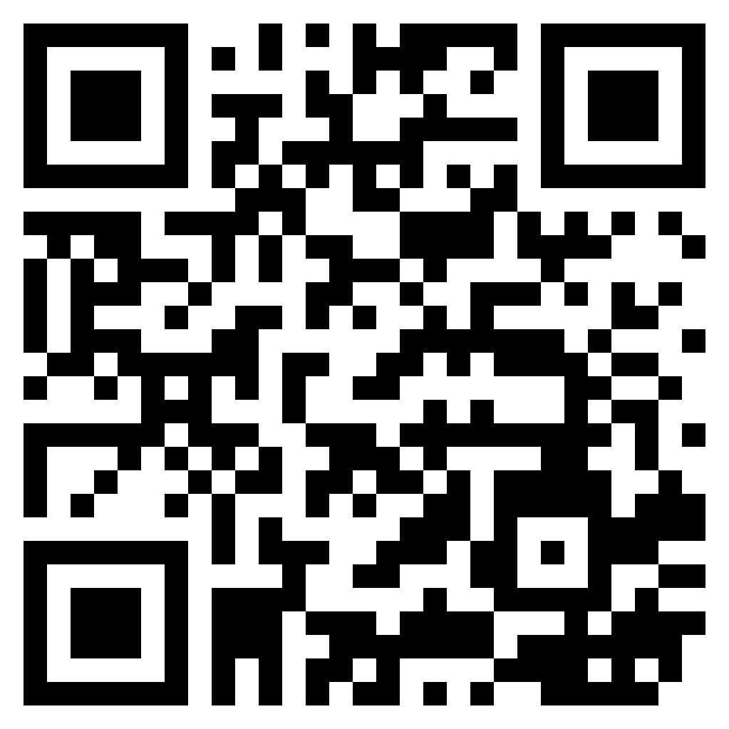
^{AFFILIATIONS}
A Scoping Review of Work-Related Studies in Nurses Diagnosed with Cancer
Kai-Lin You¹, MSN, RN, Catherine Bender¹, PHD, RN, FAAN, Laura Fennimore¹, DNP, RN, NEA-BC, FAAN, Margaret Rosenzweig¹, PHD, CRNP-C, AOCNP, FAAN,
Ketki Raina², PhD, OTR/L, FAOTA, Allison Dalby¹, Meredith Cummings¹, BSN, Teresa Hagan Thomas¹, PhD, RN
¹University of Pittsburgh School of Nursing, Pennsylvania
²School of Health and Rehabilitation Sciences, University of Pittsburgh, Pennsylvania
Background
Nurse with cancer may struggle to return to work or leave the workforce following a cancer diagnosis. The scope of work-related studies in nurses with cancer is unclear and mapping the key concepts underpinning this field is needed.
Purpose
To examine and map the work-related concepts, and identify knowledge gaps and evidence to inform future research.
Methods
PRISMA for Scoping Reviews Checklist .
Databases: PubMed, Ovid APA PsycInfo, EBSCOhost CINAHL.
Inclusion criteria: Articles with participants who were: (1) adults and registered nurses; (2) diagnosed with an advanced cancer; and (3) were employed primarily in clinical settings (clinical/managerial work), and articles about work-related issues.
Results
11 articles were included. Sample sizes: 1-130. Most common cancer diagnosis: breast cancer (53.9%). Majority were females (98.9%).
Work-related concepts: Role adjustment in work; Impact of cancer symptoms on work; Organizational support; Coping strategies for work; Gain insights for patient care; Quality of work life.
Knowledge Gaps: Theoretical frameworks were not identified. Limited diversity of samples.
Discussion & Conclusions
Limitations: limited access to articles outside databases, lack of specific suggestions.
Strategies are needed to support the career and retention of nurse with cancer in the healthcare workforce.
Who I am:
Kai-Lin You, MSN, RN
PhD Student
School of Nursing
kailinyou@pitt.edu
Scan the code to connect to me on LinkedIn ☺
What I am looking for:
Point of contact in UPMC or other organizations to help recruit nurses with cancer for my studies.
My study projects:
Focus group: to explore return-to-work experiences in nurses with cancer.
Cross-sectional survey: to examine work limitations and associated factors in nurses with cancer.
Figure 1. Research Designs
Acknowledgments:
University of Pittsburgh School of Nursing
Scholarship of Taiwan Government Sponsorship for Overseas Study.
Notes:
Questions:
[ ] QR code

