Slide 1
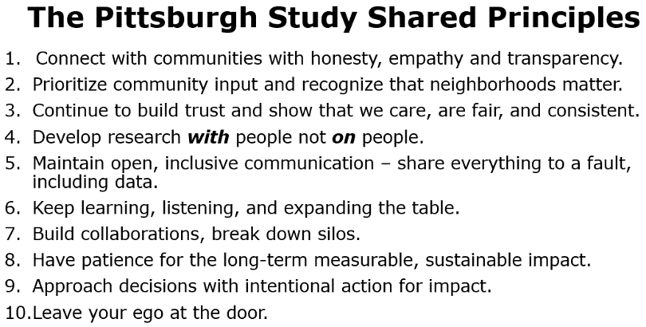
University of Pittsburgh Clinical and Translational Science Institute
Community Engagement of Diverse Populations
Community Partners and ISP Cores: Mylynda B. Massart, MD., Ph.D., RaNaja Kennedy B.S.
^{AFFILIATIONS}
MISSION
CTSI OTHER SERVICES
Integrating community members and stakeholders into the research team and research process.
Ask Me About:
Community Engaged Research and Research Reciprocity
Pitt + Me
Research Facilitators
Regulatory assistance
Statistical analysis
Impact and Evaluation
Biobanking with Discovery
Pilots
Biomedical modeling
CTRPs
Recruitment Innovation
Trial Innovation
Education
Home of All of Us PA
How to Get Involved
Research Reciprocity Example
Write an article for the New Pittsburgh Courier
Give a lunch & learn seminar to the community
Hold an engagement studio with community ambassadors to inform your research
Include a community ambassador on your research team
Apply for a Wordout, CRISP or Lifespan pilots
Record a PCORI PATH Storybooth
More Questions?
https://ctsi.pitt.edu
mbm66@pitt.edu

Slide 2
University of Pittsburgh Clinical and Translational Science Institute
Community Engagement of Diverse Populations
Community Partners and ISP Cores: Mylynda B. Massart, MD., Ph.D., RaNaja Kennedy B.S.
^{AFFILIATIONS}
MISSION
CTSI OTHER SERVICES
Integrating community members into clinical research teams and research processes by facilitating engagement that encourages collaboration between research and community.
Ask Me About:
Community Engaged Research and Research Reciprocity
Pitt + Me
Research Facilitators
Regulatory assistance
Statistical analysis
Impact and Evaluation
Biobanking with Discovery
Pilots
Biomedical modeling
CTRPs
Recruitment Innovation
Trial Innovation
Education
Home of All of Us PA
How to Get Involved
Research Reciprocity Example
Write an article for the New Pittsburgh Courier
Give a Lunch & Learn seminar to the community
Hold an engagement studio with community ambassadors to inform your research
Include a community ambassador on your research team using CPRET
Apply for a WORDOUT, CRISP or REAL pilot award
Record a PCORI PATH Storybooth
Join our Speakers Bureau
More Questions?
https://ctsi.pitt.edu
mbm66@pitt.edu

