Slide 1
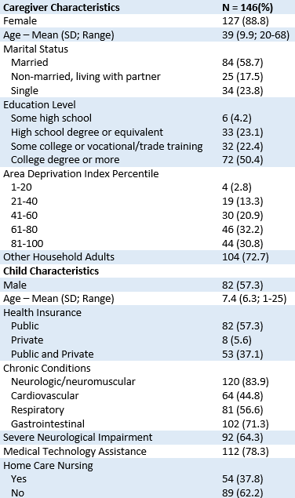
Family Caregivers of Children with Medical Complexity
Report Elevated Levels of Emotional Distress
Lydia McLachlan, BS; Justin Yu, MD, MS
Division of General Academic Pediatrics; Divisions of Supportive Care and Pediatric Hospital Medicine
Website: palcare.pitt.edu
Twitter: @PittPalCare
Email: mclachlanlm@upmc.edu
BACKGROUND
RESULTS
Family caregivers of children with medical complexity (CMC) are critical to ensuring their child’s health
Caregiver health and well-being is linked to child health outcomes
The health and well-being of the CMC caregiver population is under-described
PROMIS Mean Scores and Percentage of CMC Caregivers with Elevated Distress
48.3 %
OBJECTIVES
Describe self-reported well-being among family caregivers of CMC
Compare caregiver well-being to general US population norms
32.2 %
25.9 %
24.5 %
21.7 %
22.4 %
METHODS
13.9 %
Electronic survey of 146 caregivers of CMC receiving treatment at UPMC Children’s Hospital of Pittsburgh's Complex Care Center
Patient-Reported Outcomes Measurement Information System (PROMIS) short-forms assessed:
Global Mental Health
Emotional Distress (Anxiety, Depression, Anger)
Psychological Resources (Meaning & Purpose, Problem-Focused Self-Efficacy, Emotion-Focused Self-Efficacy)
Sleep-Related Physical Health (Fatigue, Sleep-Related Impairment)
11.9 %
Emotional Distress
Sleep-Related Physical Health
Psychological Resources
*p<.05 **p<.01 US adult female population norm
†Elevated distress is considered having a PROMIS score in the fair or poor range for Global Mental Health, the moderate or severe range for Anxiety, Depression, Anger, Fatigue, and Sleep-Related Impairment, or in the low or very low range for Meaning & Purpose, Problem-Focused Self-Efficacy, and Emotion-Focused Self-Efficacy
CONCLUSIONS
Caregivers of CMC self-report of their well-being was significantly lower than US population norms with almost one-half of our sample meeting criteria for elevated levels of emotional distress
Future interventions aiming to improve the well-being of caregivers of CMC should consider targeting symptoms of anxiety, emotion-focused self-efficacy, and sleep-related physical health

