Slide 1
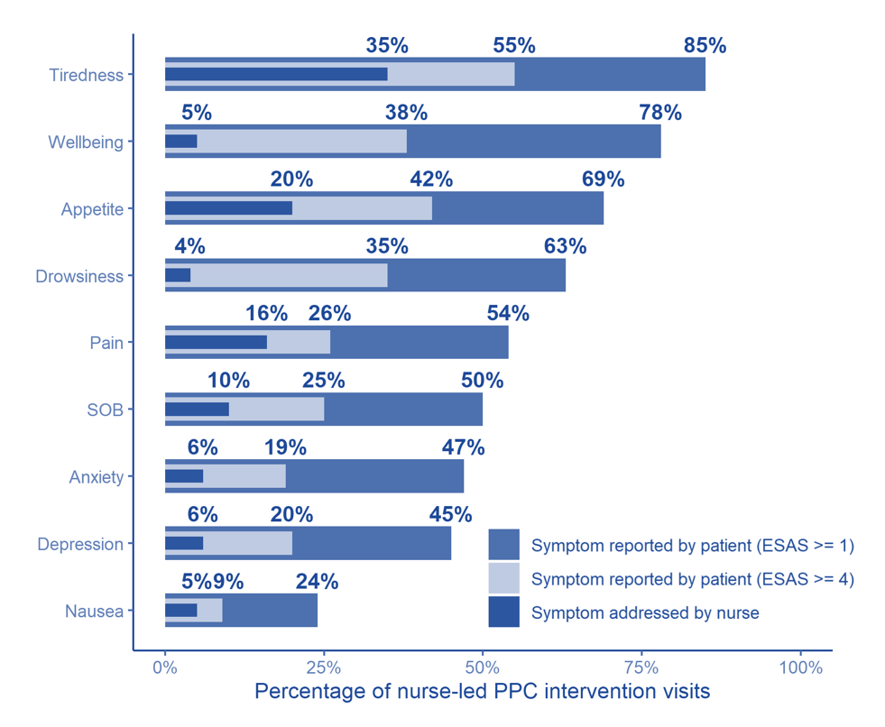
Symptom burden and shared care planning in an
oncology nurse-led primary palliative care intervention
(CONNECT) for patients with advanced cancer
Chandler J. Mitchell
Primary Mentorship: Andrew Althouse PhD, Margaret Rosenzweig PhD CRNP-C AOCNP FAAN,
Bob Arnold MD FAAHPM, Yael Schenker MD MAS FAAHPM
Background
Results
Figure 2: PPC Visits in which ESAS Symptoms Reported and Addressed by Nurses
Addition of specialty palliative care (SPC) to oncology care improves quality of life and symptom burden for patients with advanced cancer.
Specialty palliative care alone cannot meet patient demand due to workforce limitations
Primary palliative care (PPC), is the provision of palliative care by non-specialists
PPC interventions are less likely than SPC to address physical needs and have not demonstrated an impact on symptom burden.
The symptoms with the highest average severity and prevalence were tiredness, low sense of well-being, and poor appetite.
Moderately severe symptoms were addressed on SCPs ranging from 4% (drowsiness) to 35% (tiredness) of the time.
SCPs tended to include non-pharmaceutical interventions more often than pharmaceutical interventions.
Objectives
Describe the frequency and severity of symptoms experienced by a large cohort of patients with advanced cancer.
Present the symptoms addressed by CONNECT nurses on Shared Care Plans (SCPs)
Describe strategies utilized by PPC-nurses to address common cancer symptoms.
Secondary analysis of the CONNECT trial data.
235 adult, ambulatory patients with metastatic solid tumors whose oncologist ‘would not be surprised if they died within a year’.
23 oncology nurses received PPC training and conducted up to three monthly visits with patients.
Symptom prevalence and severity were assessed visit using the Edmonton Symptom Assessment Scale (ESAS)
Nurses collaboratively developed treatment strategies with patients targeting symptoms using SCPs.
Figure 1: ESAS Severity Reported by Patients with Advanced Cancer during PPC Visits
Discussion/Impact
The symptoms that patients report most frequently and as most severe on shared care plans were addressed less frequently than expected.
Future nurse-led PPC interventions should be designed with input and continual feedback from nurses, to ensure they have the training, skills and resources they need to target and manage patients’ most burdensome symptoms.
Further research is needed to understand how PPC interventions can be designed to more effectively target and improve symptom burden for patients with advanced cancer
Methods

