Slide 1
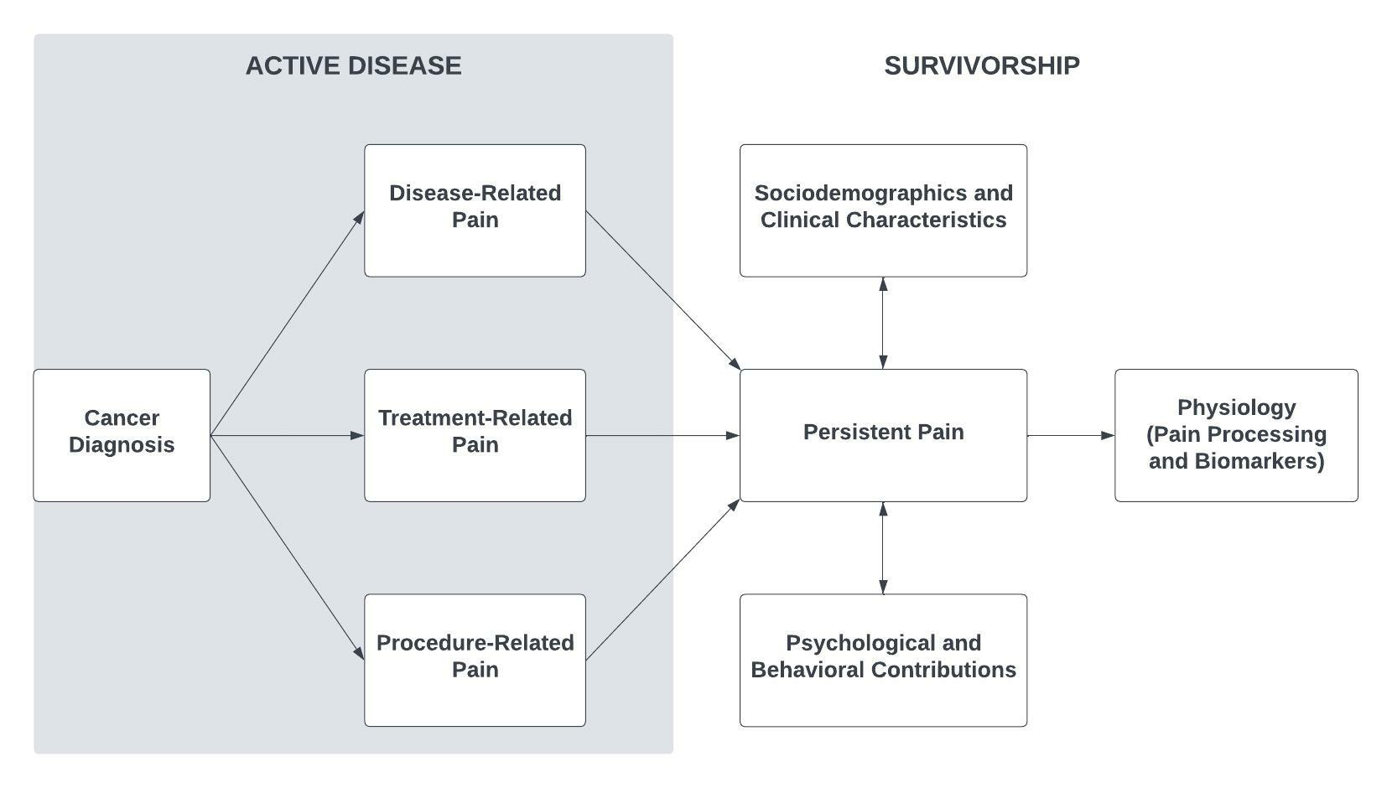
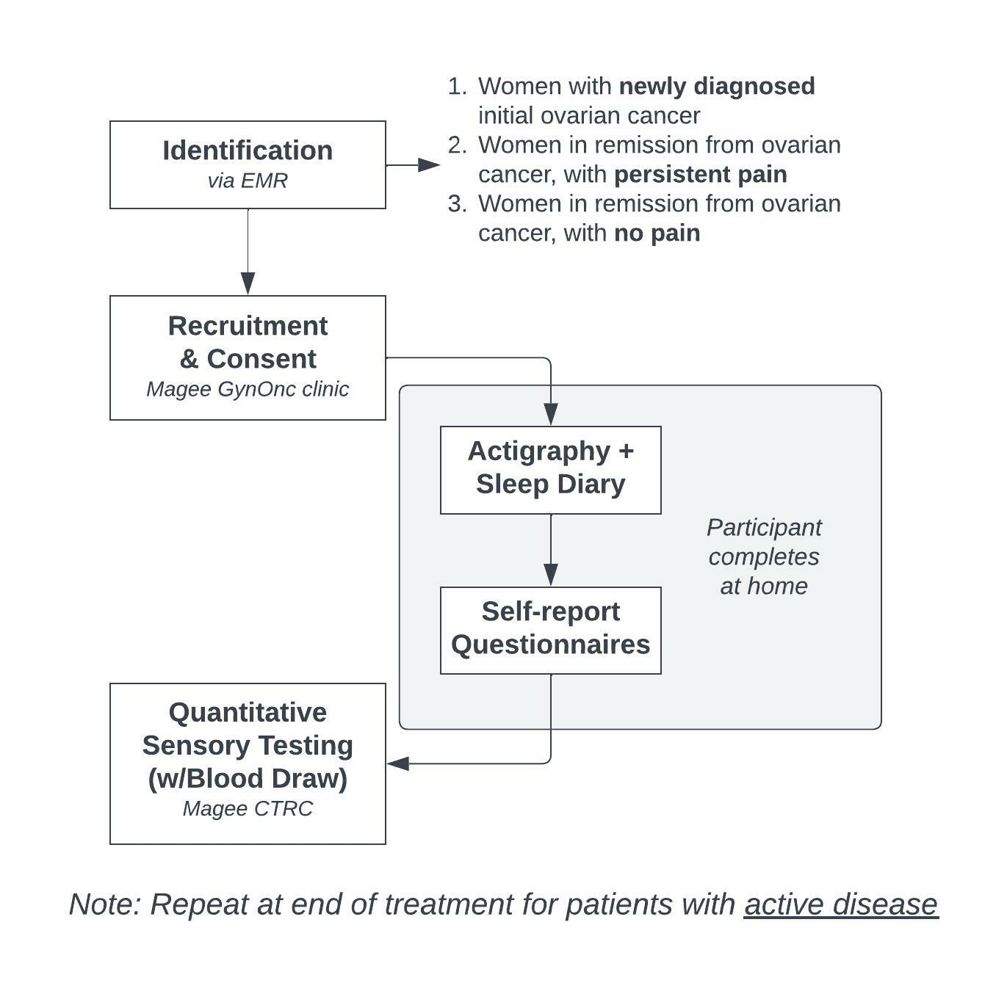
AtTACC Pain:
Assessing the Transition from Acute to Chronic Cancer Pain
Steven R. Orris, BS, Perpetua E. Buadoo, Sarah M. Orris, BS, Jessica S. Merlin, MD, PhD, MBA, Hailey W. Bulls, PhD
University of Pittsburgh School of Medicine, Department of General Internal Medicine
ACKNOWLEDGEMENTS
- Ovarian cancer is commonly diagnosed in women with an estimated 19,889 cases expected in 2022.
- Approximately 80% of initial ovarian cancer cases will respond to treatment, yet survivors in remission often suffer from persistent pain stemming from their disease and/or treatments.
- Unmanaged persistent pain is associated with adverse health outcomes including functional impairment, negative psychological impact, suboptimal health behaviors, and reduced quality of life.
- Little is currently known about the confluence of factors that facilitate the transition from acute to chronic cancer-related pain.
Fig 1. Hypothesized Model of Chronic Cancer Pain
DATA SOURCES
- Self-report questionnaires
- Electronic medical record
- Actigraphy
- Quantitative sensory testing
- Proteomics and mRNA analysis
Fig 2. Study Flow
FUTURE DIRECTIONS
Knowledge gained as part of this study will support an upcoming NCI R01 submission to conduct a large-scale, longitudinal analysis of women with an initial diagnosis of ovarian cancer and define cancer pain phenotype(s).
STUDY OBJECTIVE
MILESTONES/CURRENT PROGRESS
To obtain pilot data in support of a chronic cancer pain phenotype, focused on women with an initial ovarian cancer diagnosis, by examining clinical, biological, psychological, and behavioral factors implicated in the transition from acute to chronic pain.
- Completed healthy control arm (n=20)
- Currently recruiting patients with active disease (n=20) in partnership with the Magee Gynecologic Oncology clinic
- Recruitment of patients in remission anticipated Fall 2022
ACKNOWLEDGEMENTS
This pilot study is supported by funding from the CTSI Pain Research Challenge, KARAT Catalytic Grant, and CHAMPP Pilot Award.
Notes:
Questions:
[ ] QR code

