Slide 1
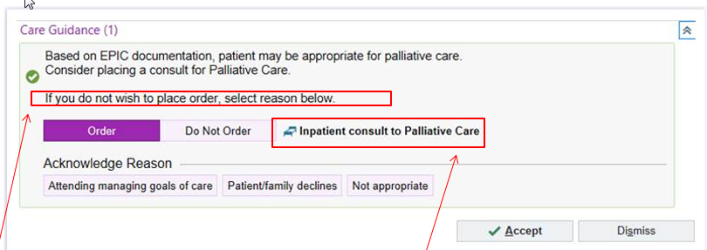
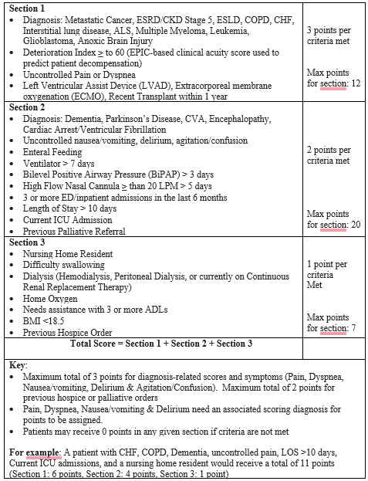
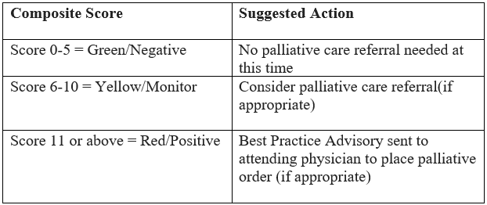
Development and Implementation of a Real-time Palliative Care Screening to Identify Earlier Palliative Care Referrals
Marika Haranis, MSN, ACHPN-BC, ACHPN¹, Natasha Lampkin, LCSW², Alva Roche-Green, MD², Jennifer Burgher Seaman, PhD, RN CHPN¹, Laura Fennimore, DNP, RN,NEA-BC, FAAN¹
University of Pittsburgh School of Nursing¹, Inova Health System²
Background
Methods
Methods
Discussion
Hospitalized patients are often referred very late or not at all due to knowledge gaps and lack of processes to assist with identifying patients for palliative referral.¹⁻³
A consensus panel convened by CAPC determined general screening criteria for use during admissions, based on national standards, research findings, and expert opinion.
Despite the criteria, there remains a lack of validated and practical screening processes for the general hospitalized patient population for everyday clinical use.⁴
A 923-bed academic medical center in Northern Virginia noted an opportunity to identify patients for palliative care earlier in hospital stay.
Project type/Timeline: Quality improvement, Pre- and post-implementation design over 17 months and including data 6 months prior to implementation (June 15, 2021-December 14, 2021) and 6 months post-implementation (December 15, 2021-June 14, 2022)
Measurement & Evaluation Plan: Time from admission to palliative referral (reported in days), referral patterns (total # of referrals, referring services)
Development Process
Best Practice Advisory
Limitations/Weaknesses include:
Project occurred at a single academic medical center
Several criteria are based on documentation by clinical staff creating variability in interpretation (e.g. ADLs & symptoms)
3) Lack of provider documentation of major diagnoses leading to lower scores
4) The best practice alert was easy to bypass and only suggested a consult
5) Difficulty accessing and interpreting data for the best practice alerts
6) The post-implementation period began during the 2021-2022 winter surge of COVID-19
Results
Decrease of 0.6% in average time to a palliative care referral from admission (p=0.939)
Increase of 3.7% in total palliative referrals (p=0.321) and 1.7% in referrals within 3 days of admission (p= 0.458)
The largest referring services both pre-and post-implementation were the hospitalists and critical care and a statistically significant increase for oncology services (p=0.035).
Tool criteria & process developed by the workgroup
Informatics team built tool & best practice alert in EMR
Pilot & chart reviews completed over 1 month
Communication regarding process to providers and clinicians
Launch of new process
Scoring Criteria
Aims
Conclusion & Further Study
Development of an evidence-based, practical, real-time screening process embedded into the electronic medical record (EMR), EPIC, for inpatient adults aimed at identifying the need for palliative care referrals within three days of admission
Implementation of the developed screening and referral process at the selected setting
Evaluation of the impact of the screening and referral process in reducing the time from hospital inpatient admission to palliative care referral
Exploration of possible factors that potentially influenced referral patterns pre-and post-implementation, including the total number of palliative care referrals and referring services
 | Pre-Implementation | Post-Implementation
Total Hospital Admissions | 18,438 | 18,224
Palliative Referrals | 909 | 942
Average # Palliative referrals/month | 152 | 157
Days from admission to consult | 5.16 days (SD 8.34; Range .00 – 80.53) | 5.13 days (SD 8.56; Range .01-97.80)
Referrals within 3 days of admission | 523 | 558
Referrals within 5 days of admission | 639 | 666
Referrals within 7 days of admission | 715 | 732
This project is an encouraging and progressive step toward a standardized tool and practical implementation for the general hospitalized population.
Future research: enlarging the scope to the other hospitals within the system or other health care organizations, reliability and validity of the developed tool, appropriateness of referrals, and the limitation of diagnosis entry and documentation and its impact.
References
1. Flaherty, C., Fox, K., McDonah, D. & Murphy, J. (2018). Palliative care screening: Appraisal of a tool to identify patients’ symptom management and advance care planning needs. Clinical Journal of Oncology Nursing, 22(4), 92-96. https://doi.org/10.1188/18.CJON.E920E96
2. Churchill, I., Turner, K., Duliban, C., Pullar, V., Priestley, A., Postma, K. & Law, M. (2020). The use of a palliative care screening tool to improve referrals to palliative care services in community-based hospitals: A quality improvement initiative. Journal of Hospice & Palliative Nursing, 22(4), 327-334. https://doi.org/10.1097/NJH.0000000000000664
3. Yen, Y., Lee, Y., Hu, H., Sun, W., Ko, M., Chen, C., Wong, K., Morisky, D., Huang, S. & Chu, D. (2022). Early palliative care: the surprise question and the palliative care screening tool—better together. BMJ Supportive & Palliative Care,12(2), 211-217. https://doi.org/10.1136/bmjspcare-2019-002116
4. Weissman, M., & Meier, D. (2011). Identifying patients in need of a palliative care assessment in the hospital setting: A consensus report from the center to advance palliative care. Journal of Palliative Medicine, 14(1), 1-7. https://doi.org/10:1089/jpm.2010.0347
Discussion
A practical real-time EMR-embedded screening tool and alert process were successfully initiated through the project.
There was essentially no difference in the average time from admission to referral.

