Slide 1
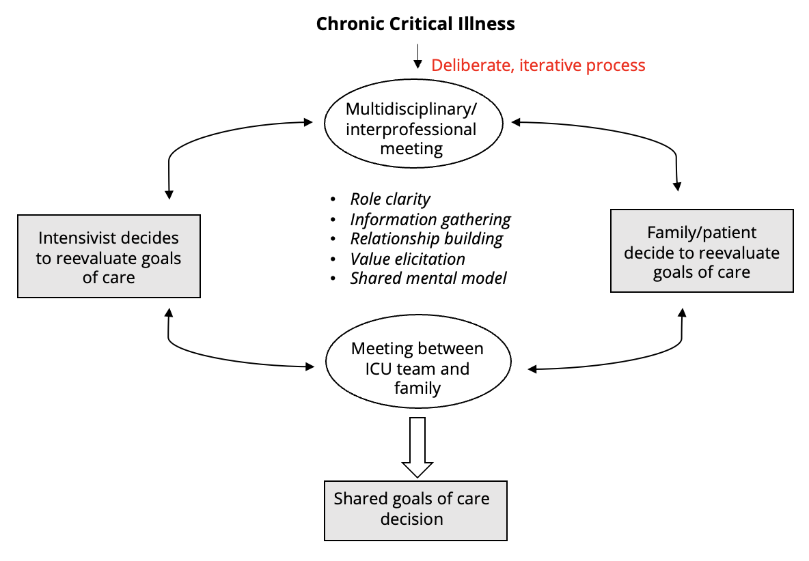
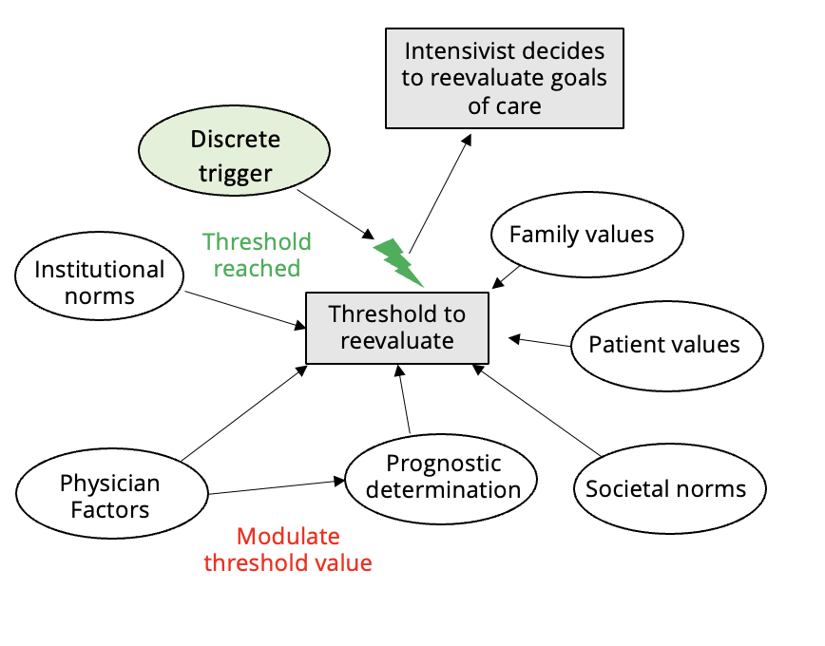
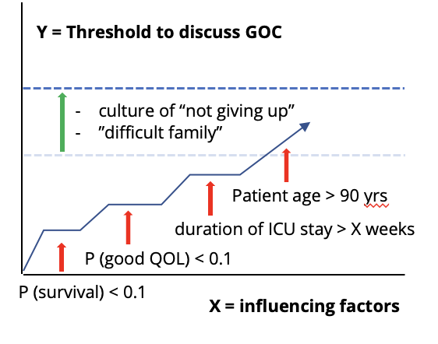
Goals of Care in Chronic Critical Illness:
A Mental Model of Decision-Making
Sarah K. Andersen MD¹, Yanran Yang PhD², Baruch Fischhoff PhD²; Douglas B. White MD, MAS¹
¹CRISMA , Department of Critical Care Medicine, University of Pittsburgh; ²Department of Engineering and Public Policy, Carnegie Mellon University
Background
Preliminary Results
Methods
Chronic critical illness (CCI) occurs in 7-10% of ICU patients and causes significant morbidity and mortality ¹
Most CCI patients lack the ability to participate in goals of care discussions
Surrogate decision makers and physicians are poorly informed about realistic outcomes¹
Physicians often direct goals of care decision-making² but this process is not well understood.
We hypothesize that societal and institutional norms may influence how and when discussions occur
Figure 1: Descriptive mental model of GOC* decision-making in CCI* shows a complex, iterative process.
Diverse sampling across health regions in 2 countries (Canada, USA)
Open-ended, semi-structured interviews of intensivists
Coding by 2 independent researchers (MD and PhD) with a focus on mental modeling
So far, 20 interviews across 4 health regions completed
“Oh, I think if you have an LTACH to send someone to, it's much easier to kind of kick the can. That's my honest opinion. It takes energy to have those challenging conversations.[…] But, if there's a family that says, you know, “this is what we want”, sometimes I think there's less likelihood to push through that and understand a little bit more when you have a place to go.”
“So, I think it requires a lot of multidisciplinary coordination for a lot of these people. Because, you know, once somebody's in the hospital that long, they're bound to have three, four or five consultants involved in their care. So you have to find all these people and get them all on the same page, you know?”
Research Questions
How do goals of care decisions get made in CCI?
How do cultural norms and health system structure influence goals of care decisions for CCI patients?
Next Steps
Characterize physician thresholds for goals of care decision-making
Compare mental models across health regions, countries
Understand the mental models of other HCPs, patients and families
Design interventions to address barriers to shared decision-making in CCI
Mental Models
Figure 2: Influencing factors on physician approach to GOC
Mental model → decisions & behavior
Mental modeling → A rigorous qualitative method³
Figure 3: Threshold model of GOC discussion
Conscious decision
Mental model
Representation of some domain that supports understanding, reasoning, and prediction.
Select References
¹ Nelson, J. E., et al. (2010). "Chronic critical illness." Am J Respir Crit Care Med 182(4): 446-454.
² Cox, C. E., et al. (2009). "Expectations and outcomes of prolonged mechanical ventilation." Crit Care Med 37(11): 2888-2894
³Thorne, S., et al. (2017). Mental Modeling Research Technical Approach. Risk, Systems and Decisions: 13-30.
*GOC: goals of care; CCI: chronic critical illness
Dr. Andersen is Funded by the National Institutes of Health (T32HL007820)
SKA33@pitt.edu
Notes:
Camhi, S. L., et al. (2009). "Deciding in the dark: advance directives and continuation of treatment in chronic critical illness." Crit Care Med 37(3): 919-925.
Mental models: tacit, complex webs of deeply-held beliefs below the surface of conscious thought
The concept of mental models has been the focus of extensive research in the field of psychology dating back to the 1930s. A person’s mental model can be thought of as a complex web of deeply held beliefs below the surface of conscious thinking that affect how an individual defines a problem, reacts to information, forms judg- ments, and makes decisions. One’s beliefs about a topic may be complete and cor- rect, or they may have consequential gaps and misperceptions that negatively influence decision making and action—behavior. Mental models are not observ- able; they can only be determined with empirical research. They are typically repre- sented using influence diagrams which depict the factors a person perceives as relevant to the issue at hand, with directional arrows showing how the value (or level) of one factor influences the value of another (Johnson-Laird 1983).
Decades of research and experience have shown that to effectively engage people through communications and enable changes in their beliefs and behaviors, one must first understand their mental models. Once these models are understood, one can then design strategies and communications that: reinforce what they know that is correct, address key knowledge gaps and misperceptions that are consequential, and use communications sources and methods that are credible and relevant to the focal stakeholders.
Mental Modeling is among the most robust of qualitative research methods. It yields rich, high-quality data on individuals thinking on complex topics, by intensive study of relatively small samples of strategically selected individuals (Morgan et al. 2002).

