Slide 1
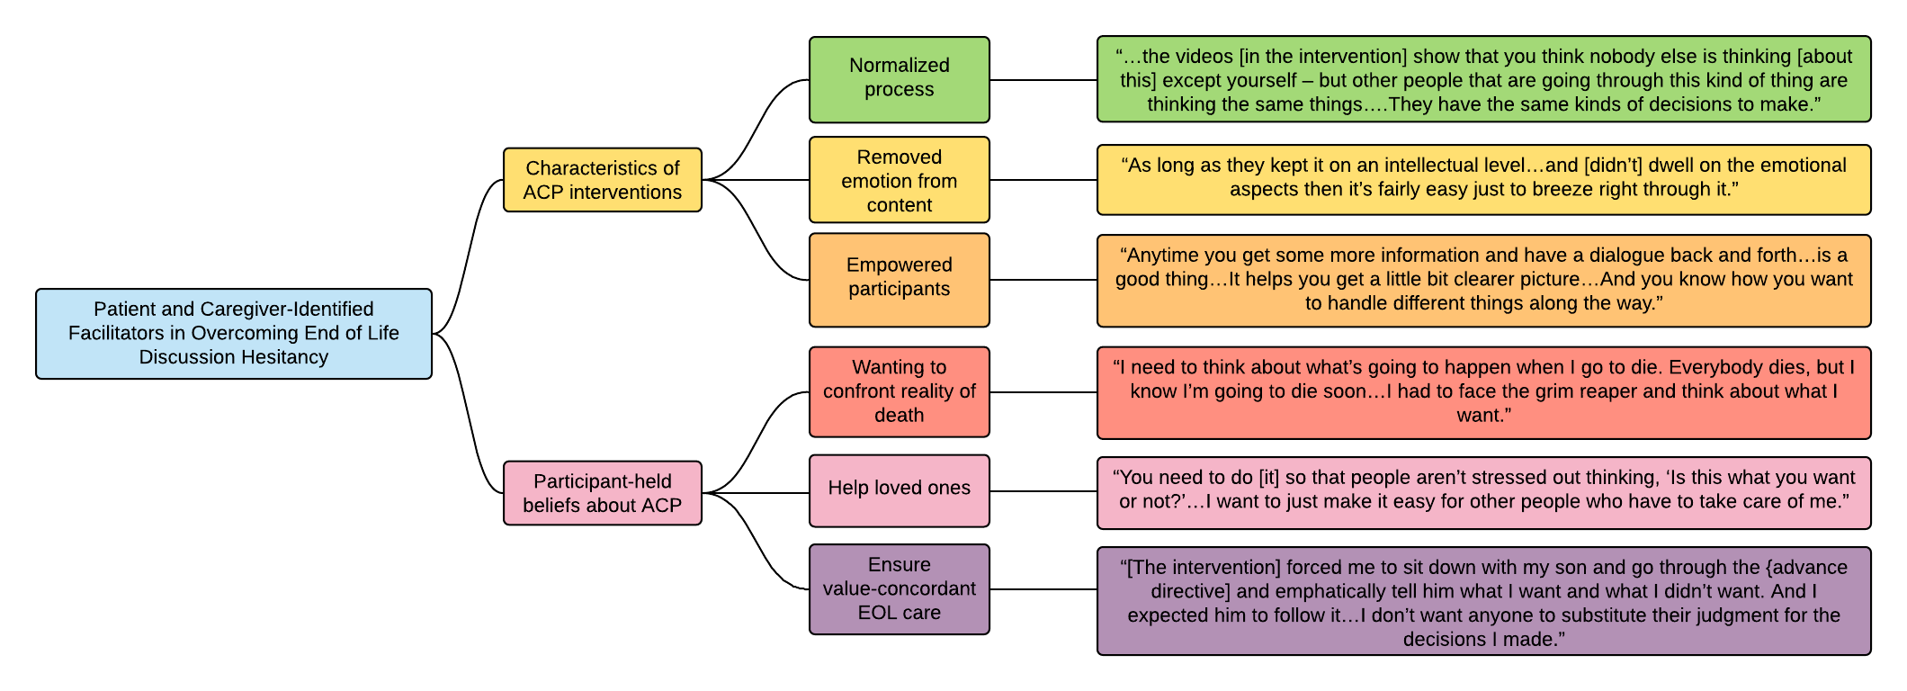
Overcoming End of Life Discussion Hesitancy in Advance Care Planning for Patients with Advanced Cancer and Their Caregivers
Website: palcare.pitt.edu
Twitter: @PittPalCare
Renusha Indralingam, BS¹; Kimberly J. Rak, PhD, MPH¹; Aaron Richardson, MS¹; Megan Crowley-Matoka, PhD²;
Douglas B. White, MD, MAS¹; Robert M. Arnold, MD, FACP, FAAHPM¹; Yael Schenker, MD, MAS, FAAHPM¹
1. University of Pittsburgh School of Medicine; 2. Northwestern University Feinberg School of Medicine
Introduction
Results
There is a need to increase end of life(EOL) care discussions between patients and caregivers who are limited by their avoidance of topics concerning death and dying.
It is unclear how patients and caregivers can overcome their initial reluctance to engage with advance care planning (ACP) or EOL discussions.
Tables 1a-c: Participant Demographics (N = 14 patients and 8 caregivers)
 | Caregivers n (%)
Relationship to Patient
Spouse/Partner | 4 (50%)
Child | 3 (38%)
Sibling | 1 (12%)
 | Patients n (%) | Caregivers n (%)
Gender
Female | 7 (50%) | 4 (50%)
Male | 7 (50%) | 4 (50%)
 | Patients n (%) | Caregivers n (%)
Race
Caucasian/White | 13 (93%) | 7 (88%)
African American/ Black | 1 (1%) | 1 (12%)
Figure 1. Patient and Caregiver Participants Identified Certain ACP Intervention Attributes and Personal Beliefs about ACP that Facilitated Subsequent EOL Care Discussions
Objectives
Explore advanced cancer patients’ and their caregivers’ experiences with EOL discussions after participating in ACP intervention
Describe facilitators that participants identified for overcoming death/dying topic avoidance
“…the videos [in the intervention] show that you think nobody else is thinking [about this] except yourself – but other people that are going through this kind of thing are thinking the same things….They have the same kinds of decisions to make.”
“…there [were] specific, different steps that she could take – almost like easing her into it, and it was less emotional for her. It became more…of a problem-solving or something like you do at work.”
“Anytime you get some more information and have a dialogue back and forth…is a good thing….It helps you get a little bit clearer picture….And you know how you want to handle different things along the way.”
Methods
“I need to think about what’s going to happen when I go to die. Everybody dies, but I know I’m going to die soon….I had to face the grim reaper and think about what I want.”
Conducted as part of NCI-funded R01 (CA235730)
Participants recruited from UPMC Hillman Cancer Center Network
Patient-caregiver pairs randomized to discussion-based vs. online-video-based ACP
After 12 weeks, participants completed semi-structured, in-depth, audio-recorded phone interviews
Interviews were transcribed and coded for major thematic content
“You need to do [it] so that people aren’t stressed out thinking, ‘Is this what you want or not?’….I want to just make it easy for other people who have to take care of me.”
“[The intervention] forced me to sit down with my son and go through the [advance directive] and emphatically tell him what I want and what I didn’t want. And I expected him to follow it….I don’t want anyone to substitute their judgment for the decisions I made.”
Conclusions
Implications
After participating in an ACP intervention, participants found it easier to engage in EOL conversations when
Characteristics of the ACP interventions worked to increase participants’ sense of control
Participants believed ACP could achieve certain psychological and care-related goals
To foster EOL discussions between patients and caregivers
Death/dying topic avoidance should be recognized as a common response
ACP should be goal-oriented and focus on increasing sense of agency

