Slide 1
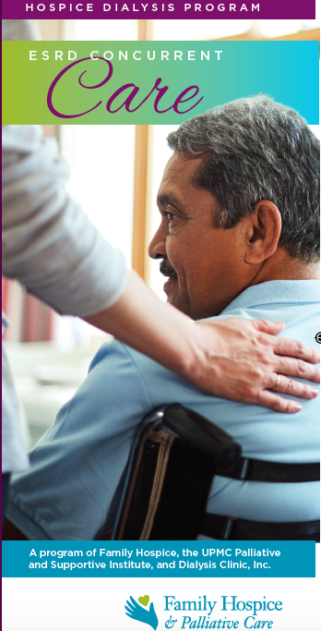
Description and Outcomes of an Innovative
Concurrent Hospice-Dialysis Program
Mayumi T. Robinson, MA¹, Natalie C. Ernecoff, PhD, MPH², Alexandra Bursic, MD¹, Erica M. Motter, MA¹, Keith Lagnese, MD³, Robert Taylor, MD⁴, Jane O. Schell, MD, MHS¹
¹University of Pittsburgh School of Medicine, Pittsburgh, PA, ²RAND Corporation, Pittsburgh, PA, ³Prospero Health, Boston, MA, ⁴Dialysis Clinic, Inc., Nashville, TN
BACKGROUND
Hospice care is too little, too late for people living with ESKD
25% of patients receive hospice services at end-of-life
40% receive hospice services for ≤3 days
OBJECTIVE: Describe (1) the Program and (2) enrollment and utilization characteristics of Program participants
RESULTS
Utilization | N=43 n (%)
Number of patients who received ≥1 dialysis treatment after hospice enrollment | 20 (46.5)
Dialysis treatments received during hospice enrollment (mean ± SD, range)
Hemodialysis | 3.5 ± 2.8, 1-9
Peritoneal dialysis | 19.2 ± 26.3, 3-65
Hospice length of stay (days) (median, range) | 9.0, 1-76
Among patients who received ≥ 1 dialysis treatment after hospice enrollment | 13.0, 4-76
Location of death
Home | 28 (65.1)
Inpatient hospice | 10 (23.2)
Skilled nursing facility | 5 (11.6)
Hospital | 0
METHODS
Retrospective chart review
CONCURRENT CARE PROGRAM
Collaborative pilot between Family Hospice, UPMC Palliative Supportive Institute, & Dialysis Clinics Inc.
Provides palliative dialysis alongside hospice care
Goals:
Increase hospital length of stay
Improve patient, family and provider experience
CONCLUSIONS
Patients had a median hospice length of stay longer than previously reported 5-day median
Most patients received no further dialysis treatments
Our findings support the development of innovative care models for patients with ESKD at end of life
Mayumi Robinson mtr40@pitt.edu
Notes:
Questions:
[ ] QR code

