Slide 1
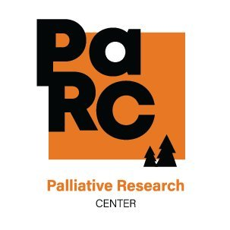
The Impact of Caregiver-Patient Relationship on Caregiver and Patient-Reported Outcomes in the Advanced Cancer Setting
Adam Whitsett, BS; Andrew Althouse, PhD; Teresa Hagan Thomas, PhD, RN
Background & Objective
There are numerous studies that identify characteristics and demographics of caregivers as “high-risk” for negative psychological impacts(i.e., being an adult child caregiver), but there are limited studies examining the role patient-caregiver relationship has on outcomes.
Aim: Analyze the interplay between caregiver-patient relationship status on caregiver and patient-reported outcomes in an advanced cancer primary palliative care setting.
Results
Conclusions
Adult child caregivers report spending much less time per week on caregiving activities, but also indicate elevated burden scores (ZBI) and comparable anxiety and depression scores (HADS-A,-D) as compared to spouse caregivers.
Although there may be additional factors at play that impact caregiver and patient reported outcomes (age of caregiver, severity of patient illness, etc.) it is useful to understand how these variables can have an impact on the dyad.
Caregiver and Patient Demographics, ZBI, and HADS scores
Implications
Through identification of factors that predispose caregivers and patients to increased risk, targeted primary palliative care interventions can be designed to mitigate strain and improve outcomes for caregivers and patients alike.
CONNECT Cluster Randomized Control Trial
Trial Details:
Intervention delivered by infusion room nurses with the aim of improving patient-reported outcomes compared to standard care alone.
672 patients enrolled to participate.
Baseline data consisting of demographic information, Zarit Buden score (ZBI) , HADS (anxiety and depression measures) were collected among patients and caregivers.
Data used for analysis:
Patient and caregiver (N=431) demographic data was collected.
Baseline data for caregivers including relationship to patient, hours spent caregiving per week, ZBI, and HADS were obtained for analysis.
Next Steps
Continued analysis of additional caregiver and patient data to better understand the relationship between caregiver risk status and dyadic outcomes.
Identify factors that predispose cancer caregivers to worse outcomes to help build targeted supportive care interventions
Time spent caregiving: 212 Spouse caregiver respondents (28 reported “around-the-clock” care), 96 adult child caregiver respondents (3 reported “around-the-clock” care)
“Around-the-clock” responses were excluded from means
ZBI is scored on a 0-48 scale (48 indicating the most burden)
HADS is scored from 0-21 for each measure (21 indicating highest degree of anxiety/depression
t.thomas@pitt.edu

